Slide 1
Precise Skin Detection in Facial Video Recordings Using Synthetic Data
Institut für Biomedizinische Technik (IBMT)
(CMS VC Team Project)

Slide 2
Main highlights
2 papers specific to skin and face segmentation and part labelling
Backbones performance comparison
Deeplab V3+ repository for keras implementation

Slide 3
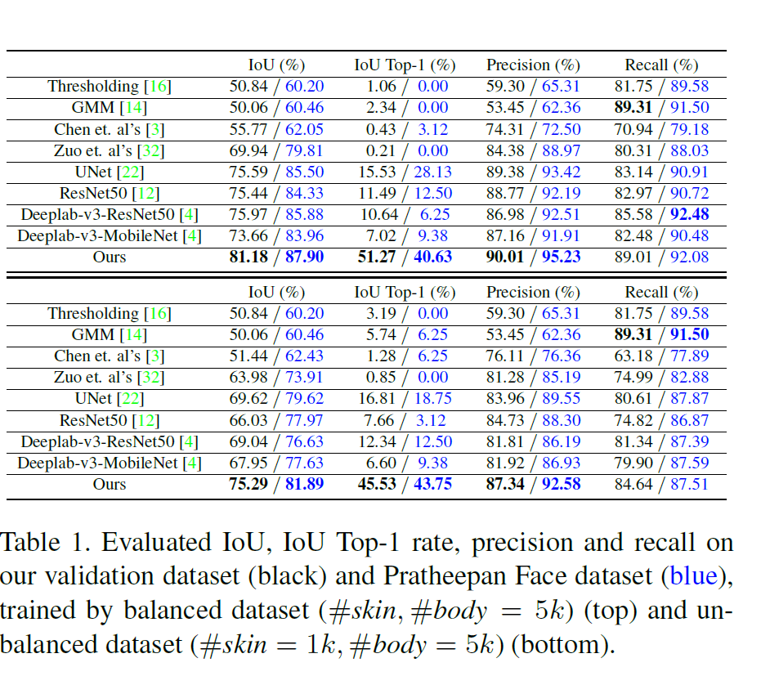
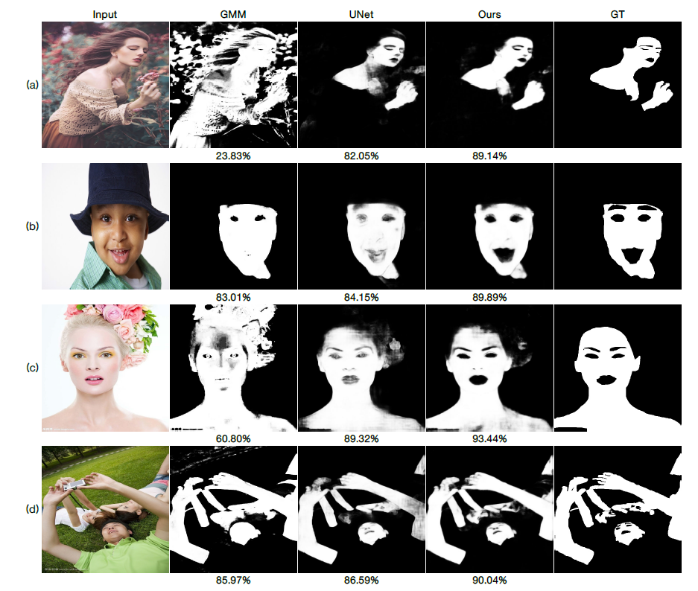
Semi-supervised Skin Detection by Network with Mutual Guidance
Reference: Semi-supervised Skin Detection by Network with Mutual Guidance
https://arxiv.org/abs/1908.01977

Slide 4
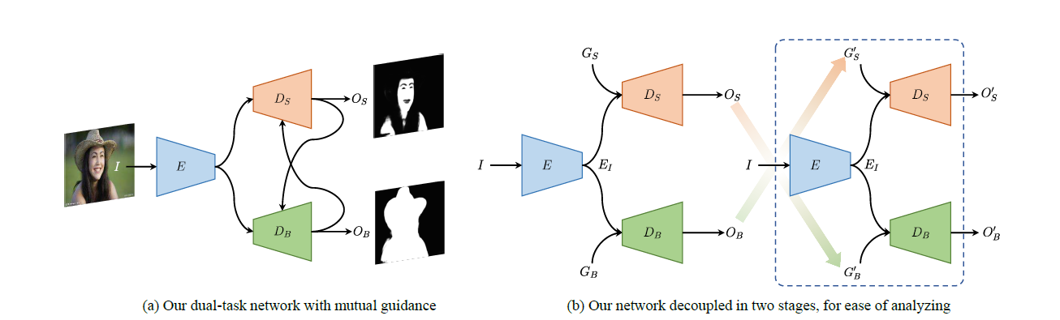
Structure of dual-task network with mutual guidance
Reference: Semi-supervised Skin Detection by Network with Mutual Guidance
https://arxiv.org/abs/1908.01977

Slide 5
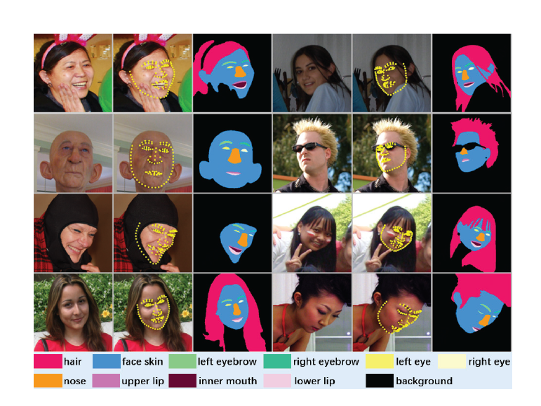
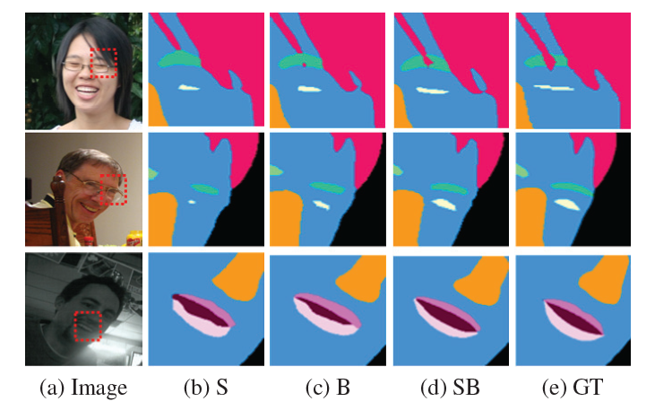
Boundary-Attention Semantic Segmentation
Reference: A New Dataset and Boundary-Attention Semantic Segmentation for Face Parsing
https://aaai.org/ojs/index.php/AAAI/article/view/6832/6686

Slide 6
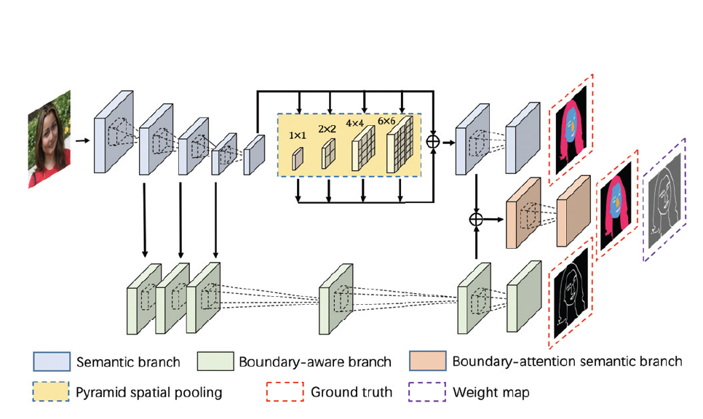
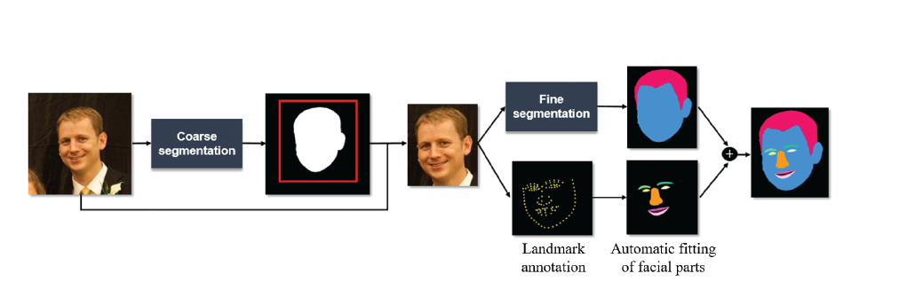
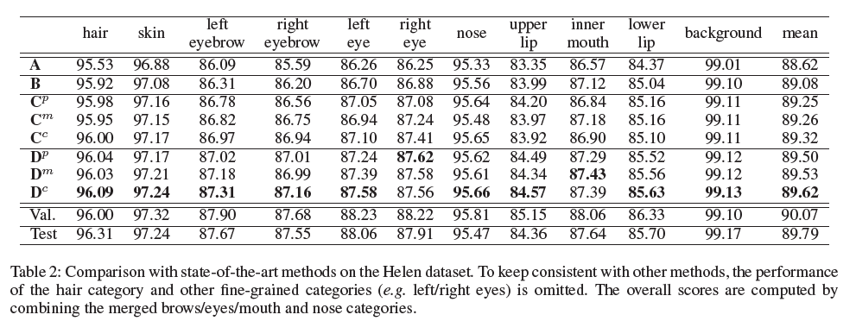
Structure of Boundary-Attention Semantic Segmentation
Reference: A New Dataset and Boundary-Attention Semantic Segmentation for Face Parsing
https://aaai.org/ojs/index.php/AAAI/article/view/6832/6686

Slide 7
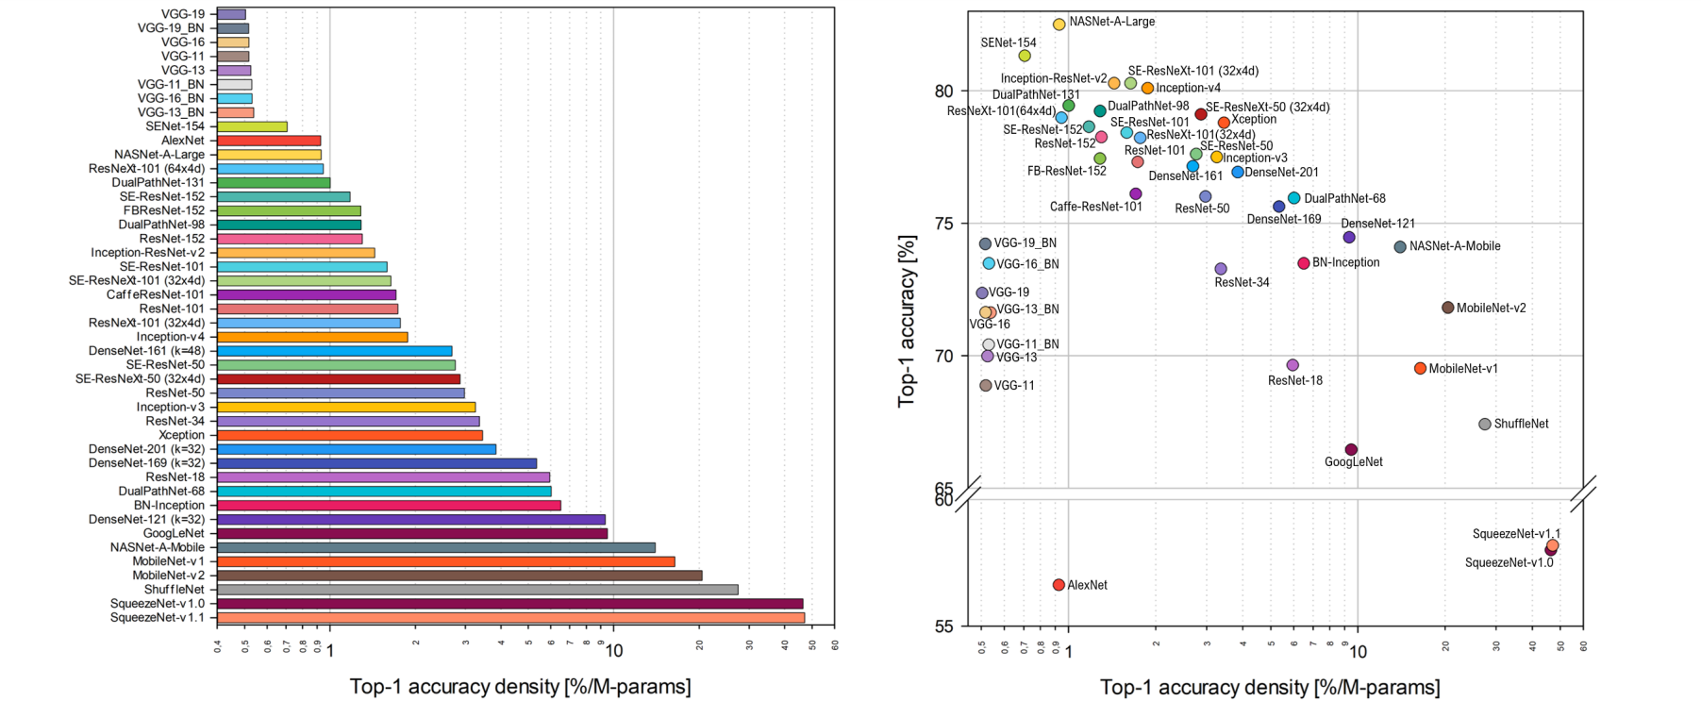

Comparison of Performance of various DNN model as backbones
The accuracy density measures how efficiently each model uses its parameters
Reference: Benchmark Analysis of Representative Deep Neural Network Architectures
https://arxiv.org/pdf/1810.00736.pdf

Slide 8
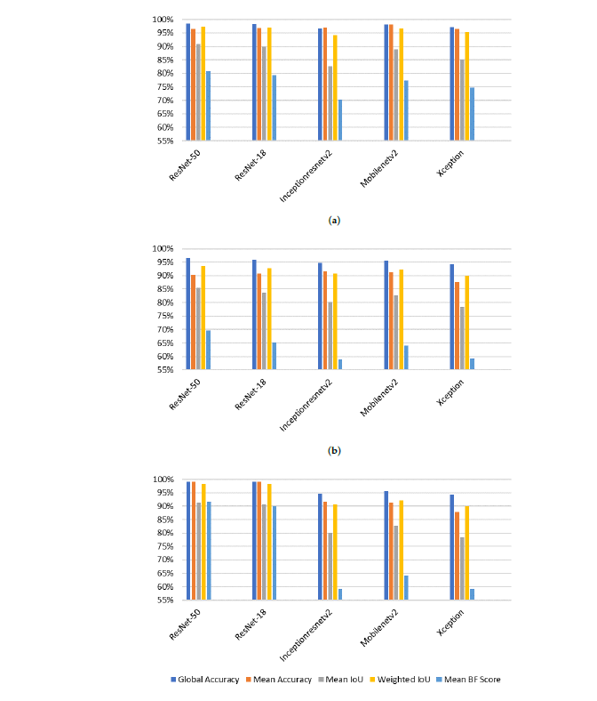
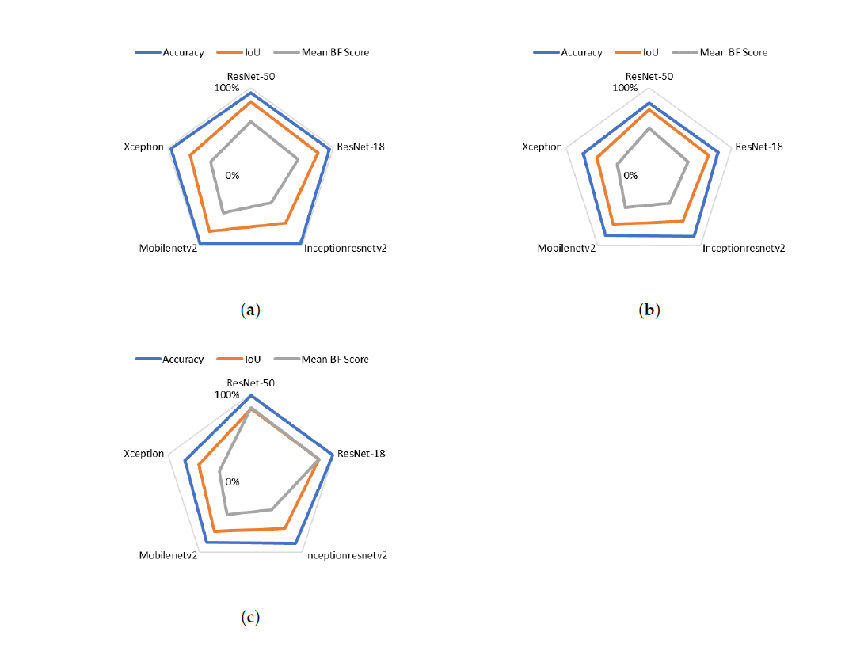
Dataset Metrics applied to the three datasets of human head detection referenced respectively by subfigures (a–c) (right)
Reference: New End-to-End Strategy Based on DeepLabv3+ Semantic Segmentation for Human Head Detection
https://pubmed.ncbi.nlm.nih.gov/34502738/

Slide 9
DeepLab V3 plus Keras implemetation
Repository: https://github.com/bonlime/keras-deeplab-v3-plus
Sample notebook for retraining: https://github.com/Golbstein/Keras-segmentation-deeplab-v3.1/blob/master/segmentation.ipynb
Implementation in two backbones
  Xception
  Mobilenetv2
Trained on cityscapes dataset with 400,000 images
Xception vs MobileNetv2
  There are 2 available backbones.
  Xception backbone is more accurate but has 25 times more parameters than MobileNetv2.
  For MobileNetv2 there are pretrained weights only for alpha=1. However, you can initiate model with different values of alpha

